Slide 1
Chapter 3 Human–Computer Interaction
By
Dr. Nilesh M. Patil

Slide 2
Syllabus
User Interfaces and Interaction for Widely Used Devices
Hidden UI Via Basic Smart Devices
Duration: 8 Hours

Slide 3
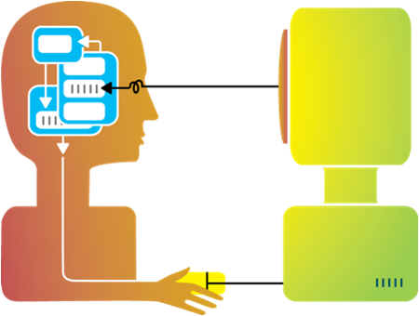
Introduction to HCI
Human Computer interaction (HCI) is characterized as a dialogue or interchange between the human and the computer because the output of one serves as the input for the other in an exchange of actions and intentions.
HCI is the study of interaction between people (users) and computers.
Human Computer Interaction is concerned with the design, evaluation and implementation of interactive computing systems for human use and with the study of major phenomena surrounding them.
Human Computer Interaction (HCI) is an interdisciplinary field in which computer scientists, engineers, psychologists, social scientists and design professional play important roles.

Slide 4
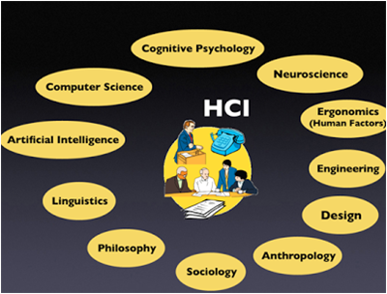
Human Computer Interaction (HCI) is an Interdisciplinary field

Slide 5
Human Computer Interaction (HCI)
HCI tackles questions concerning how people interact with computers
Are computers intuitive or complicated?
Are computers rewarding or frustrating?
How can computers be made accessible to everybody (e.g. different physical abilities, different languages, etc.)?
To what level can computer interaction be standardized?
Are computers “user-friendly”?
What does it mean to be “user-friendly”?

Slide 6

Human Computer Interaction has Three Components
Human
Computer
Interaction
The goal of HCI is to improve the interaction between users and computers by making computers more user-friendly and receptive to the user's needs.

Slide 7
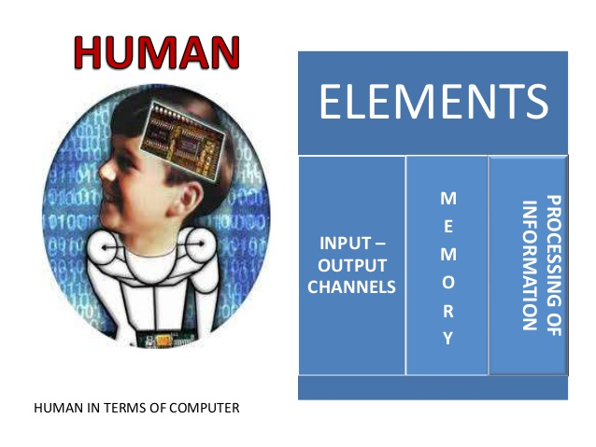
Model Human Processor
Card, Moran and Newell (1983), described the Model Human Processor (MHP)
A simplified view of the human processing involved in interacting with computer system.

Slide 8
Why do we need to understand Humans?
Interacting with technology is cognitive.
Human information processing referred to as cognition
Human cognition process is involved when interacting with system, like attention, perception and recognition, memory, learning, reasoning, problem solving and decision making.
Need to take into account cognitive processes involved and cognitive limitations of users.
Provides knowledge about what users can and cannot be expected to do.
Identifies and explains the nature and causes of problems users encounter.
Supply theories, modelling tools, guidance and methods that can lead to the design of better interactive products.
Must consider what are users good and bad at?

Slide 9
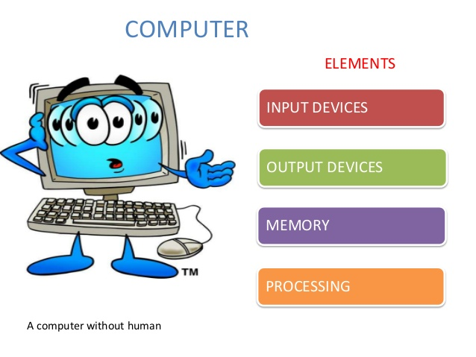
Computer In fact, the most sophisticated machines are worthless unless they can be used properly by men.

Slide 10
What is Interaction?
communication
user system
Interaction refers to a dialogue generated by the command and data, input to the computer and the display, output of the computer and the sensory/perceptual input to the human and motor response output of the human.
There are number of ways in which the user can communicate with the system, batch input, direct manipulation etc.

Slide 11
What is Interface?
Interface is made up of a set of hardware devices and software tools from the computer side and a system of sensory, motor and cognitive processes from the human side.
Interaction takes place at the Interface,

Slide 12
Donald Norman’s model
Norman’s model concentrates on user’s view of the interface
Seven stages
user establishes the goal
formulates intention
specifies actions at interface
executes action
perceives system state
interprets system state
evaluates system state with respect to goal
Notes:
Note: Donald Norman; a professor emeritus of cognitive science at University of California, San Diego and a Professor of Computer Science at Northwestern University. Donald Norman is an academic in the field of cognitive science, design and usability engineering and a co-founder and consultant with the Nielsen Norman Group.

Slide 13
execution/evaluation loop
goal
user establishes the goal
formulates intention
specifies actions at interface
executes action
perceives system state
interprets system state
evaluates system state with respect to goal
execution
evaluation
system

Slide 14
execution/evaluation loop
goal
user establishes the goal
formulates intention
specifies actions at interface
executes action
perceives system state
interprets system state
evaluates system state with respect to goal
execution
evaluation
system

Slide 15
execution/evaluation loop
goal
user establishes the goal
formulates intention
specifies actions at interface
executes action
perceives system state
interprets system state
evaluates system state with respect to goal
execution
evaluation
system

Slide 16
execution/evaluation loop
goal
user establishes the goal
formulates intention
specifies actions at interface
executes action
perceives system state
interprets system state
evaluates system state with respect to goal
execution
evaluation
system

Slide 17
User interface (UI)
User interface: User interfaces mediate the interaction (dialog) between humans and computers.
The User Interface today is often one of the most critical factors regarding the success or failure of a computer system
[[
Good UI design:
Increases efficiency
Improves productivity
Reduces errors
Reduces training
Improves acceptance

Slide 18
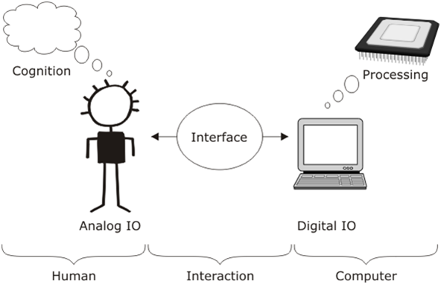

Slide 19
Basic user interface styles
Five commonly encountered user interface paradigms:
Interface style
Command entry Menu Forms WIMP Natural language
Expressive
Intuitive

Slide 20
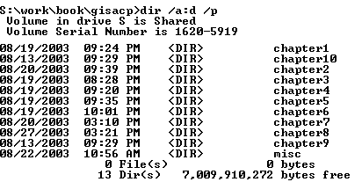
Command line interface
Command entry: human user issues commands directly to the computer.
Many different options customize commands (expressive).
Requires user to learn large numbers of commands and options (not intuitive).

Slide 21
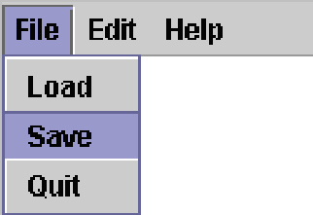
Menu interface
Menu interface: commands organized into logical groups (more intuitive than command entry)
A submenu can be used to present further related list of sub-functions or options
Menu structure limits range of options (less expressive than command entry)
Restricted form of WIMP

Slide 22
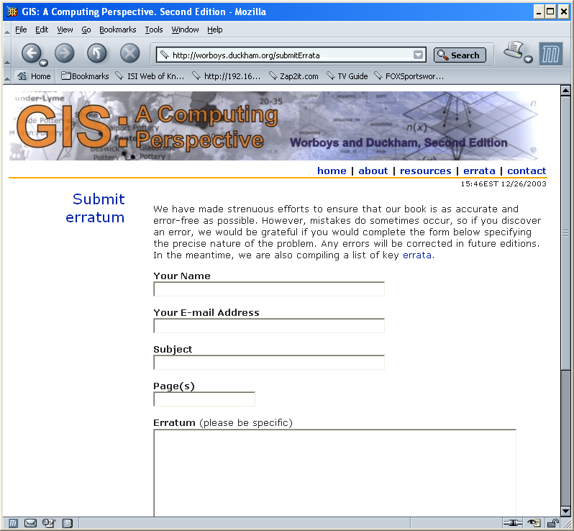
Form Interface
Form interface: presents specific questions to which a user must respond in order to perform some task.
Intuitive, since users are led step by step through interaction.
Not expressive, since form allows access to only a few specialized commands

Slide 23
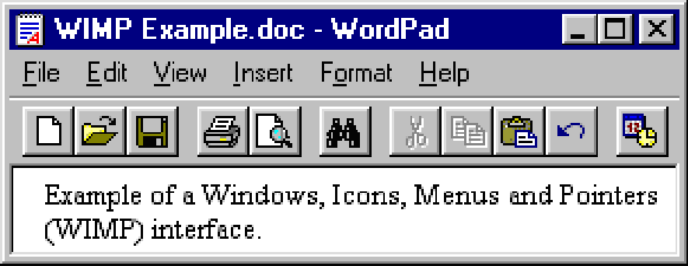
WIMP
WIMP: stands for windows, icons, menus, pointers
WIMP interfaces are familiar as they are the basis of most desktop-computer operating systems

Slide 24
Some other Interaction styles
Question/answer and query dialogue
Point and click
Direct Manipulation
Three–dimensional interfaces
Gesture Recognition
Gaze Detection
Speech and Speaker Recognition
Pen based Interaction
Motion Tracking sensors and Digitizers
Taste and smell sensors

Slide 25
Principles of User interface design
Simple and natural dialogue
Speak the user’s language
Minimize user’s memory load
Provide feedback
Provide clearly marked exits
Provide shortcuts
Deal with errors in a positive manner
Provide help

Slide 26
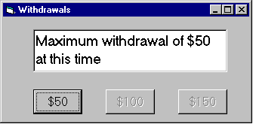
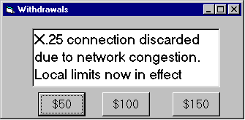
Example: Speak the users’ language
Terminology based on users’ language for task
e.g. withdrawing money from a bank machine
Use meaningful mnemonics, icons & abbreviations
e.g File / Save

Slide 27
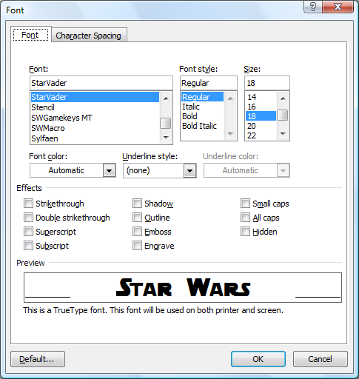
Example: Minimize user’s memory load
Computers good at remembering, people are not!
Promote Recognition over Recall
menus, icons, choice dialog boxes vs. commands, field formats
relies on visibility of objects to the user (but less is more!)

Slide 28
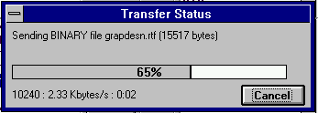
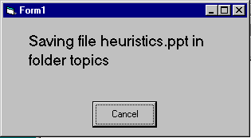
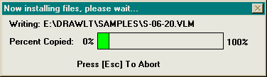
Example : Provide feedback
Continuously inform the user about
what it is doing
how it is interpreting the user’s input
user should always be aware of what is going on
Multiple files being copied, but feedback is file by file.

Slide 29
Suggestions for Interface Designs
HCI has traditionally been about designing efficient and effective systems.
Well-designed interfaces can elicit good feelings in users.
Expressive interfaces can provide comforting feedback.
Badly designed interfaces make people angry and frustrated.
Emotional interaction is concerned with how we feel and react when interacting with technologies.
Emotional interaction is concerned with how interactive systems make people respond in emotional ways.
Relaxed users will be more forgiving of shortcomings in design.
Aesthetically pleasing and rewarding interfaces will increase positive affect.

Slide 30
Suggestions for Interface Designs cont..
User interfaces should be designed to match the skills, experience and expectations of its anticipated users.
System users often judge a system by its interface rather than its functionality.
A poorly designed interface can cause a user to make terrible errors.
Poor user interface design is the reason why so many software systems are never used.
Designers should be aware of people’s physical and mental limitations (e.g. limited short-term memory) and should recognise that people make mistakes.

Slide 31
USABILITY
Basic Goal of HCI
One of the key concepts in HCI.
It is concerned with making systems easy to learn and use
A Usable system is:
Easy to learn
Easy to remember how to use
Effective to use
Efficient to use
Safe to use
Enjoyable to use

Slide 32
In order to produce computer system with good usability;
Developers must attempt to
Understand
The factors that determine how people use technology
Develop
Tools and techniques to enable building suitable systems
Achieve
Put People 1st
Their needs, capabilities and preferences for conducting various tasks should direct developers in the way that they design systems
Efficient, effective, and safe interaction
People should not change their way they use the system to fit with it, instead system should match their requirements
The long term goal:
To design systems that minimize the barrier between the human’s cognitive model of what they want to accomplish and the computer’s understanding of the user’s task

Slide 33
Why is usability important?
Poor usability results in
anger and frustration
decreased productivity in the workplace
higher error rates
physical and emotional injury
equipment damage
loss of customer loyalty
costs money

Slide 34
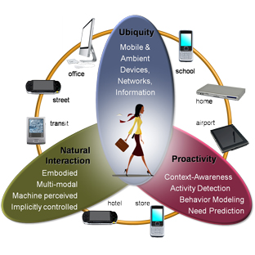
Role of HCI in Pervasive Computing

Slide 35
Role of HCI in Pervasive Computing
The technology should be invisible, hidden from sight. To develop information appliances that fit people's needs and lives. To do this companies must change the way they develop products.
They need to start with an understanding of people: user needs first, technology last-- the opposite of how things are done now.
Now, computers become pervasive. They are
embedded in everyday objects……
Users do not care about what is inside the box, as long as the box does what they need.

Slide 36
Explicit HCI
User is always at the center of interaction.
System control responds to and generated by human
System is not driven internally but by user.
Complex to coordinate lot of inputs by different devices to perform concurrent activities.

Slide 37
HCI motivation
To support more effective use.
useful: accomplish a user task that the user requires to be done
usable: do the task easily, naturally, safely (without danger of error)
used: enrich the user experience by making it attractive, engaging, fun, etc.
The success of a product depends largely on both the user’s experience with how usable a product is and how useful it is in terms of the value it brings to them.

Slide 38
Haeckel’s law and inverse law
Heckel’s law states that the quality of the user interface of an appliance is relatively unimportant in determining its adoption by users if the perceived value of the appliance is high.
Heckel’s inverse law states the importance of the user interface design in the adoption of an appliance is inversely proportional to the perceived value of the appliance.
Although the usability of the UI is important, the overriding concern is the usefulness of the device itself.

Slide 39
Implicit HCI motivation
Explicit HCI (eHCI) design supports direct human intervention.
Pure explicit interaction is context free.
Users must repeat and reconfigure the same application access every session even if every session repeats itself.
It is also more about H2C (Human to Computer) Interaction.
Focus is on the human having a model of the system (a mental model) rather than the system having a model of the individual user.

Slide 40
Implicit HCI (iHCI)
Eg: Person entering dark room
Its an action, performed by the user that is not primarily aimed to interact with a computerised system but which such a system understands as input.
Context aware
C2H (Computer to Human) Interaction
Computer has a certain understanding of users’ behaviour in a given situation(additional input)
Complex to design than eHCI.

Slide 41
Complexity and challenges of iHCI
To accurately and reliably determine the user context
Systems may also require time to learn and build an accurate model of a user.
The user context determination may invade and distract users’ attention

Slide 42
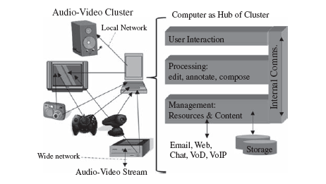
Ubiquitous audio video content access

Slide 43
Continued…
Individual voice, video and audio services are often not aware of each other and sometimes are not user configurable.
Eg: when a voice call arrives, TV and radio are automatically paused or muted.
Voice calls can be recorded in answer phone devices but they cannot easily be exported or reformatted.
To support such dynamic service composition requires the use of a pervasive network infrastructure, standard multimedia data exchange formats and certain metadata.

Slide 44
Ubiquitous information access and E-books
Personal digital calendar- can be accessed through different devices.
Pull type interaction allows users to initiate the information exchange e.g.: searching the web.
Push type notification services are used for customers to be notified of events, e.g., news.
PC remained the dominant interactive information access device, but not in all cases e.g.: kitchen, which motivated use of mobile devices.
Electronic information access is better as compared to papers.

Slide 45
Universal local control of ICT system

Slide 46
User-Awareness and Personal Spaces
Personalization can make the system customized.
Configuration of services can also be personalized.
E.g.: coordinate and configure different home appliances
Complex issue is to manage shared social spaces.

Slide 47
Diversity of ICT Device Interaction
Usually, a PC is a device with a programmable chip, haptic i/o, and visual UI.
Embedded systems are used in a device to perform specialized tasks and have different i/o interfaces
Devices are characterized based on
size: hand-sized, centimetre-sized, decimetre-sized versus micro-sized versus body-sized or larger;
haptic input: two-handed versus one-handed versus hands-free operation;
interaction modalities: single versus multiple;
single user versus shared interaction: in personal space, friends’ space or public space;.
posture for human operator: lying, sitting, standing, walking, running, etc.;
distance of output display to input control: centimeters to meters;
position during operation: fixed versus mobile;
connectivity: stand-alone versus networked, wired versus wireless;
tasking: single-task devices versus multi-task devices;
multimedia content access: voice and text communication-oriented, alphanumeric data or text-oriented, AV content access;
integrated: embedded integrated devices versus dynamically interoperable devices.

Slide 48
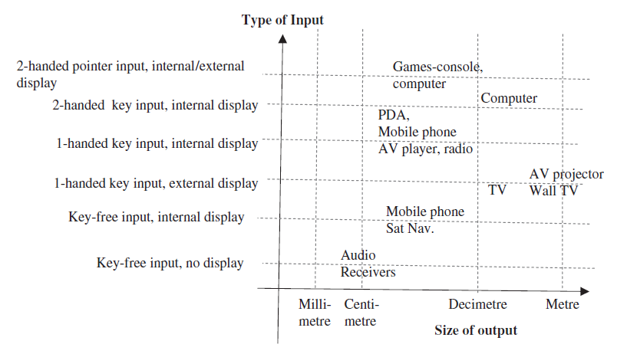
The range of ICT device sizes in common use in the 2000s

Slide 49
UI and Interaction for Four Widely Used Devices
Personal computer,
Hand-held mobile devices used for communication,
Games consoles and
Remote-controlled AV displays, players and recorders. ,

Slide 50
PC Interface
Early interfaces- command based
In 1995 WIMPS interface was introduced
WIMPS- not only commands but interactive screen objects can be controlled
WIMPS(window, icon, menu, pointer devices)
Most dominant interface- can perform direct manipulations

Slide 51
WIMPS interface
WIMPS interface is associated with a desktop metaphor.
Documents relate to Windowed areas of the screen.
Windows can be arranged in stacks, created, discarded, moved, organized and modified on the display screen using the pointer device(Direct manipulation)
Advantages of the WIMPS UI over the command UI
Order of multiple commands is ad-hoc
Users do not need to remember command names

Slide 52
Dialogues in WIMP
Dialogues are mechanisms in which users are informed about pertinent information that they must acknowledge receipt of or they ask for input to constrain a query.
Typically, this interface is displayed as a pop-up window called a dialog box.
E.g. Form filling dialog interfaces are used by many applications for alphanumeric data input like information systems or for data output like spreadsheets
These enable applications to receive data input in a structured way, reducing the processing used by a computer.

Slide 53
Drawbacks of WIMP
not necessarily an improvement for visually impaired users
consumes screen space which is more critical in lower-resolution displays;
the meaning of visual representations may be unclear or misleading to specific users;
mouse pointer control and input require good hand-eye coordination and can be slow.

Slide 54
Mobile handheld device interface
PC style WIMPS is not effective on mobile devices because
Display area is smaller.
It is impractical to have several windows open at a time.
It can be difficult to locate windows and icons if they are deeply stacked one on another
Difficult to resize windows.
Screen navigation using fingers on a touchpad or an external device may be too big and unwieldy for small devices.
In addition, the keyboard is smaller for user input and there is a greater variety of input devices.
Instead of using the inbuilt device interface, the device can be attached to different kinds of external input interface PC-style

Slide 55
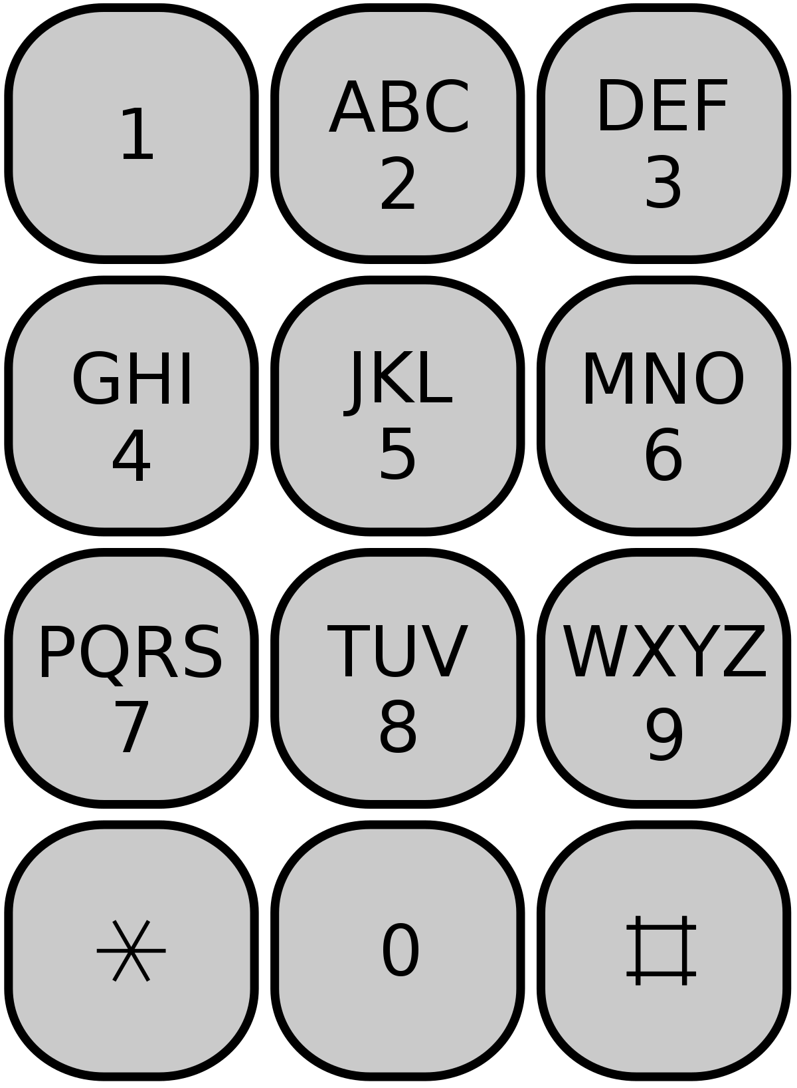
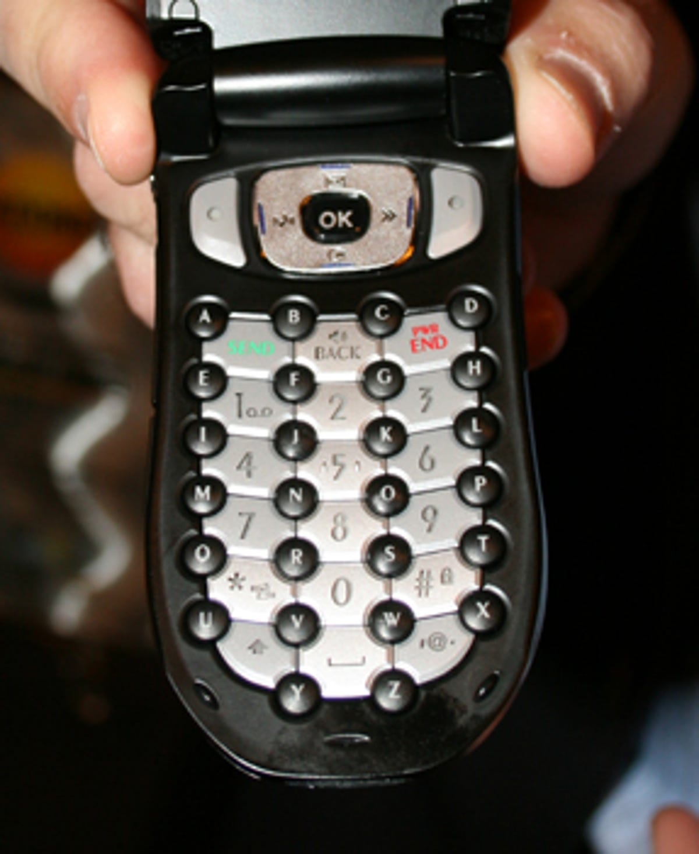
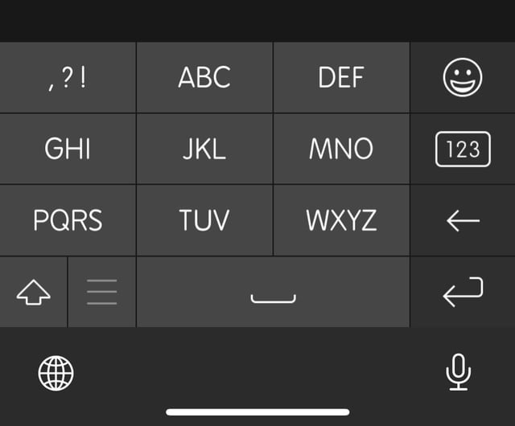
Handling limited key input
Different modes- limited number of keys and the minimum key size
Same interface interaction can lead to different action
Multi-Tap, T9, Fastap, Soft keys and Soft Keyboard
Multitap-12 keys having combinations(Explicit)
T9 –enhances experience of multitap(implicit)
Fastap-two keypads, one with smaller keys raised at the corners above the other keypad keys.
The upper one is used for alphabetic input, the lower one for number input,
If several keys are hit at once, a technique called passive chording allows the system to work out what the user intended to enter.

Slide 56
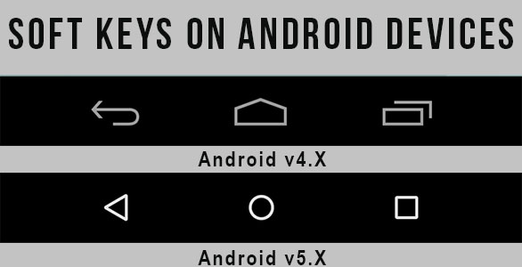
Continued..
Soft keys-two left and right keys at the top of keypad to be determined by information on the screen;
Allows the same keys to be reused to support application and task specific choices.
Instead of having two soft keys, a whole mini keyboard, a soft keyboard, could also be displayed if there is sufficient screen space.
Internal pointer devices like tracker pad, roller pads, mini joysticks ,keyboard arrow keys can be used to move the pointer on the screen.
Touch screens whose areas can be activated using some physical stick like pointer, pen or a finger
Auditory interfaces used for voice commands

Slide 57
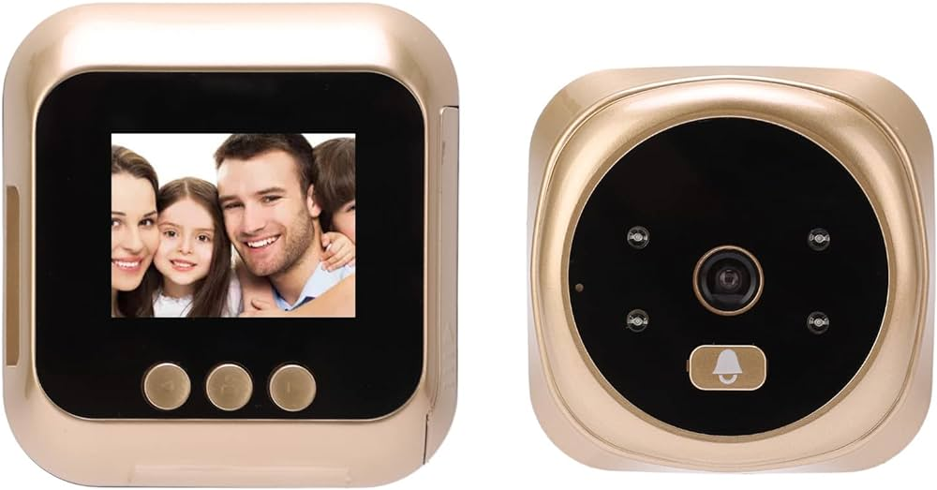
Handling Limited Output
If output is too large, it can be cropped, content resolution can be reduced or a zooming interface can be used.
Zooming (in and out) coupled with scrolling (up and down) and panning (side to side) control enables users to view contents in an interactive way.
Marking which part of the whole view that is currently zoomed in is also useful for orientation.
Peephole display uses Sensors to determine the position of the device in relation to the user
Use of projectors or organic displays(foldable) for displaying large contents on small display
Audible outputs can be used for vehicle navigation.
Haptic outputs can also be used as an output device.(e.g., urgency of call can be conveyed from the vibrations)

Slide 58
Games console interface
Seven different generations of game consoles are available based on the technologies they use.
Current, seventh generation, game consoles include the Nintendo Wii
Nintendo contains micro sensors in the form of accelerometers located inside the controller and an infrared detector to sense its position in 3D space.
Scoring system is often tuned to the interface(as the game progresses, it becomes difficult to score points)
Wii wand(natural interface) make it easy for the user to interact with the system and become immersed in the virtual game environment.

Slide 59
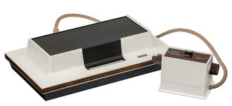
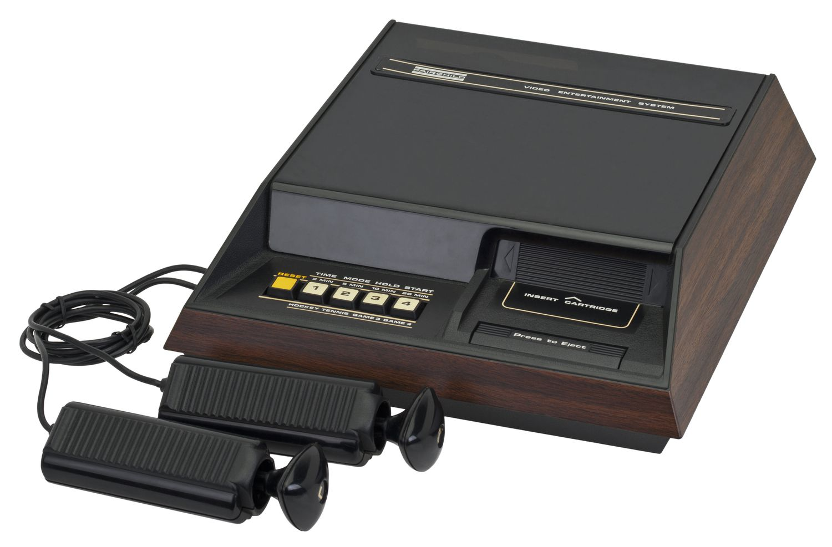
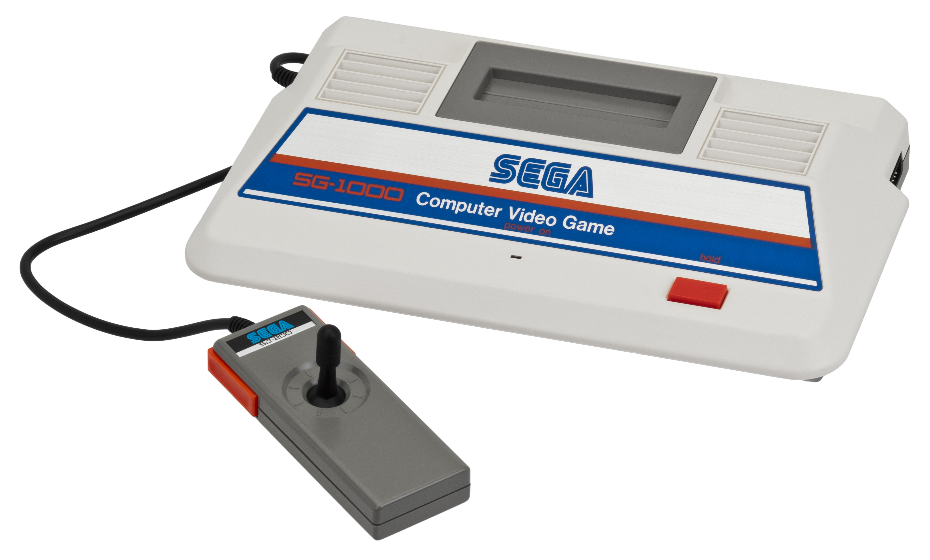
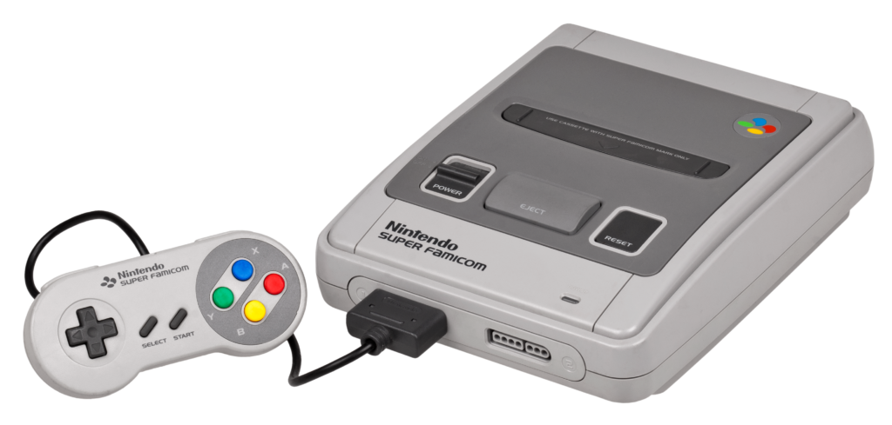
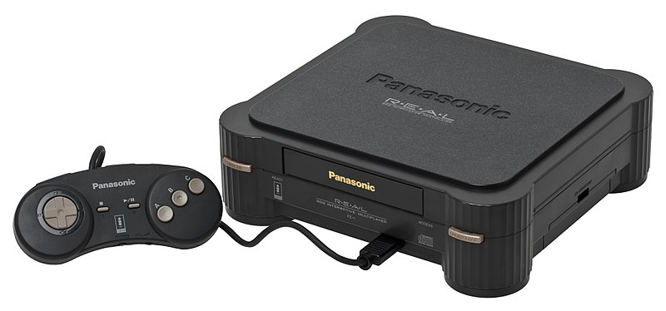
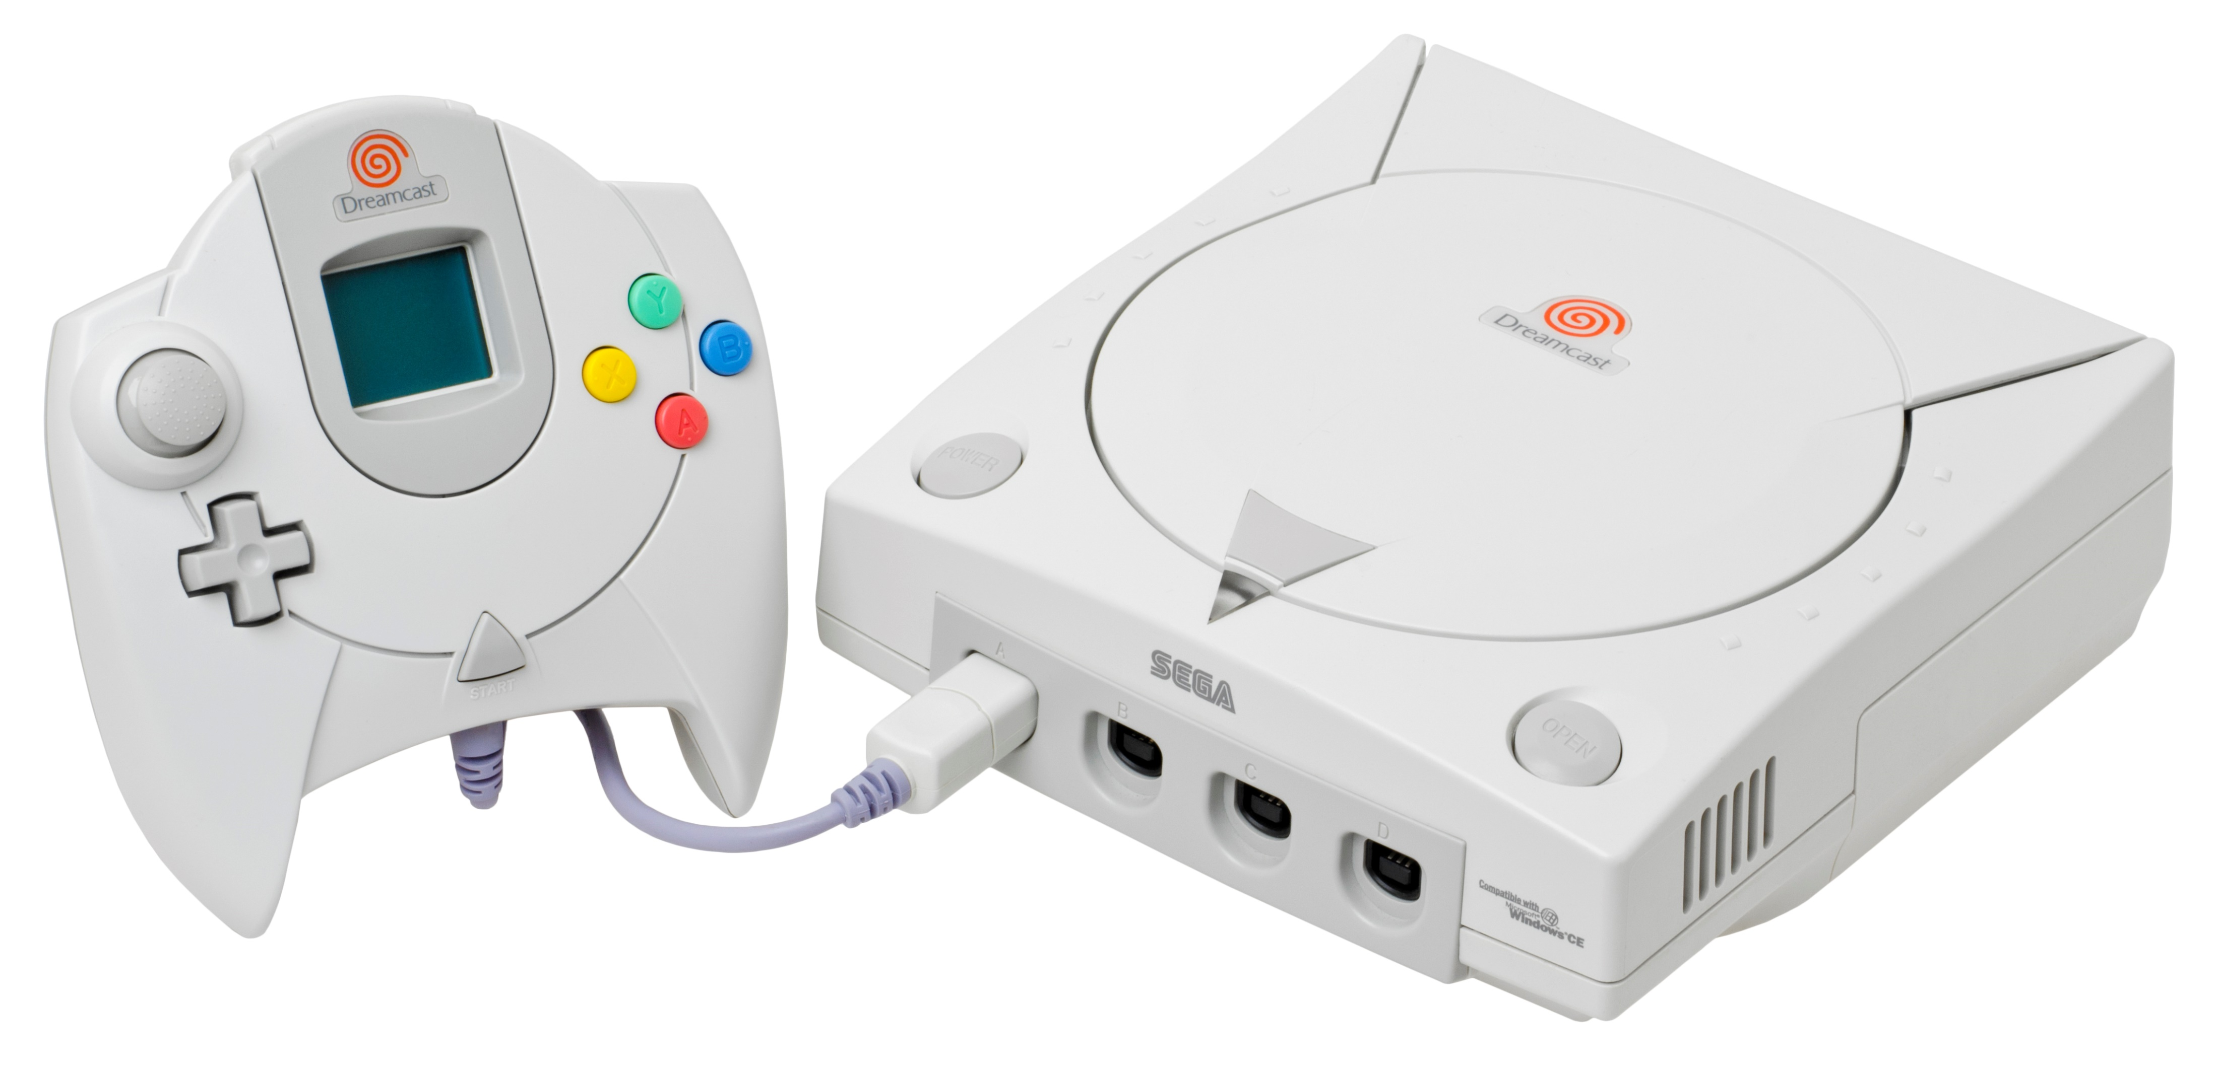
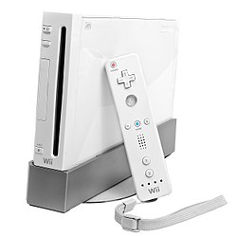
1st Generation
2nd Generation
3rd Generation
4th Generation
5th Generation
6th Generation
Generation of Game Consoles
7th Generation

Slide 60
Localised remote control
To reduce the degree of manual interaction
Design issue- overlapping features ,devices need to be orchestrated with respect to a common feature.
Eg: increasing volume of home entertainment system
Solution-universal localised remote control

Slide 61
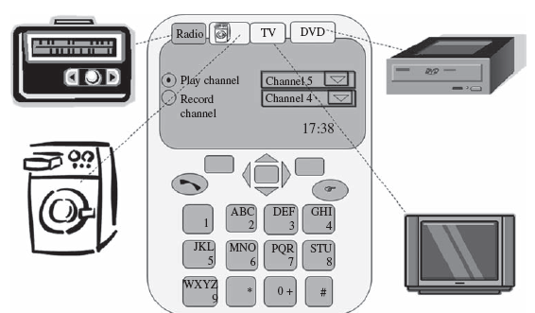
Universal local remote control

Slide 62
Hidden UI Via Basic Smart Devices
WIMPS is more obtrusive-needs users to think continuously
More natural interfaces are required –gestures, senses, speech etc
Multimodal interface , gesture interface, natural language interfaces

Slide 63
Multimodal interface
Modality- mode of human interaction using one of the human senses-5 senses
human senses such as cameras ,touch screens, microphones ,chemical sensors .
Majority of ICT system have single mode- but human interaction is multimodal.
Eg: attentive interface-rely on attention
wearable interface- worn by user
vision based human motion analysis system

Slide 64
Gesture interface
Meaningful and expressive body movements
Can be sensed by
wearable device-gloves
magnetic trackers
body attachments- accelerometers, gyroscopes
computer vision techniques
Two types of gestures
Contactful gesture-handshake, use of touchscreen
Contactless gesture- waving at someone
Eg: Sony’s eye toy, current devices having gyroscope

Slide 65
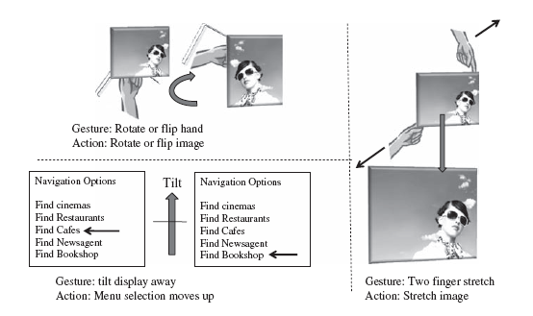

Slide 66
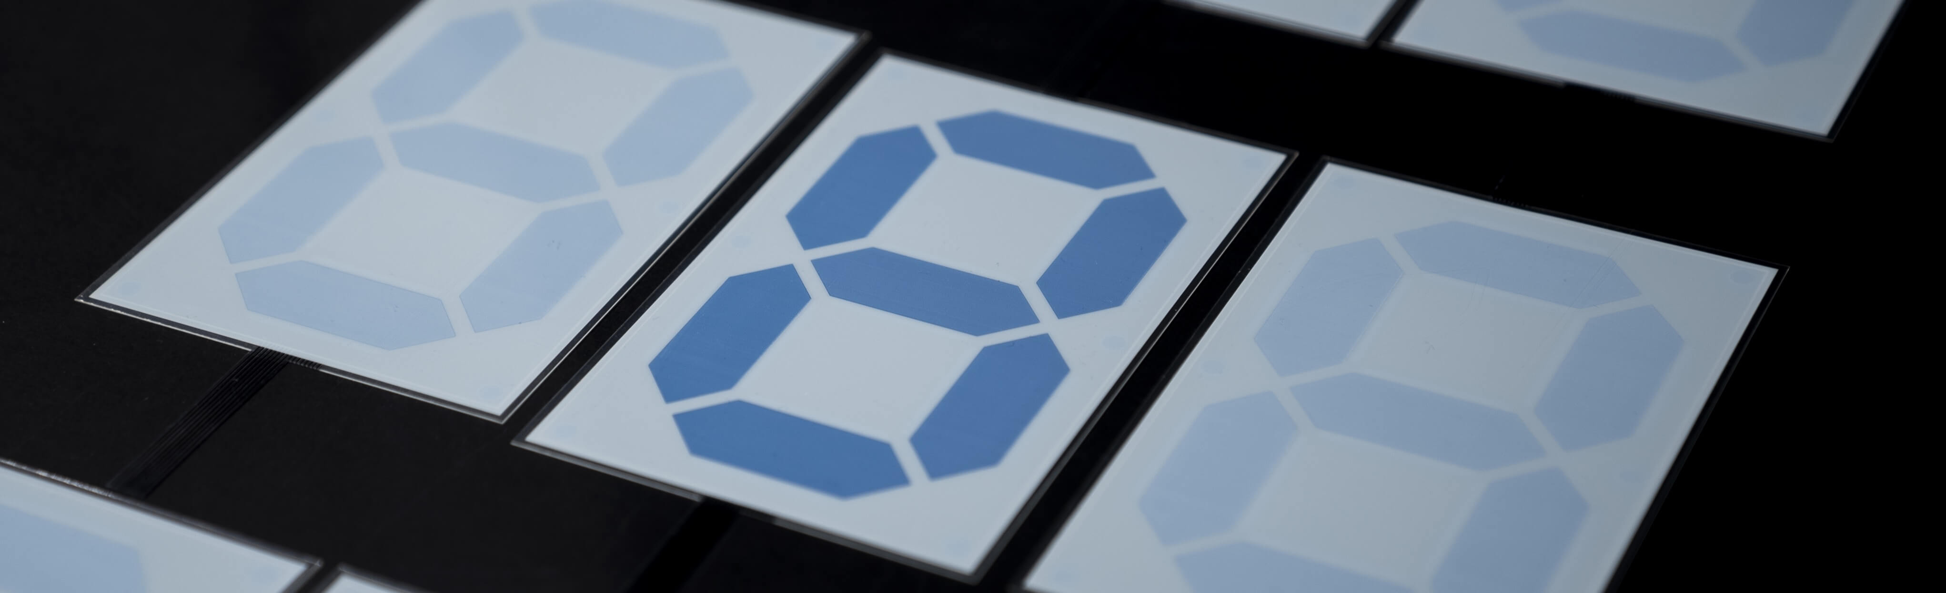
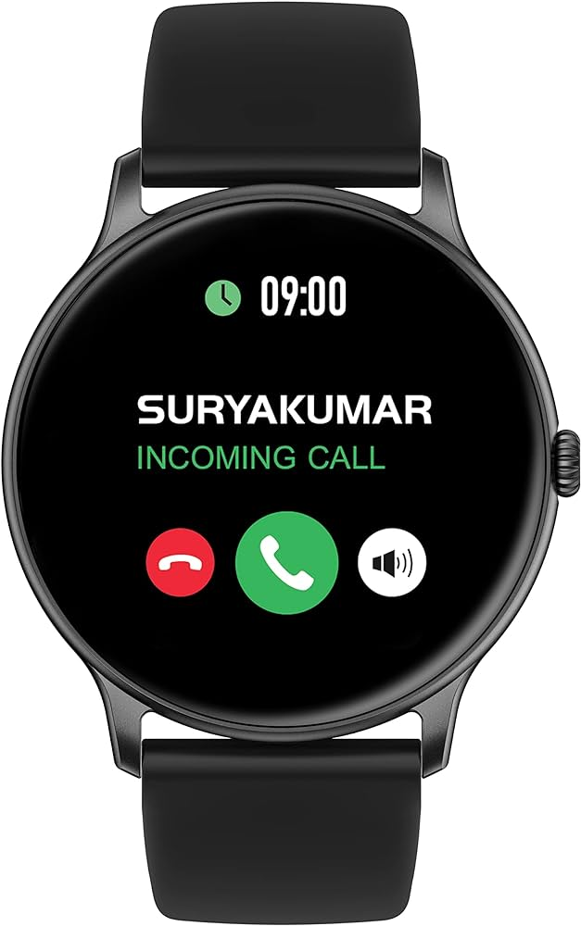
Reflective Versus Active Displays
Ebooks are light weight, thin, long lasting powered, pocket sized devices with touch screens enabling pages to be turned by touch.
It differs in type of display it uses- reflective
No energy required, readable in sunlight, can be read from any direction
Based on electrophoretic display
EPDs –electrophoretic phenomenon of charged particles suspended in a solvent.
Displayed text and images can be electrically written or erased repeatedly

Slide 67
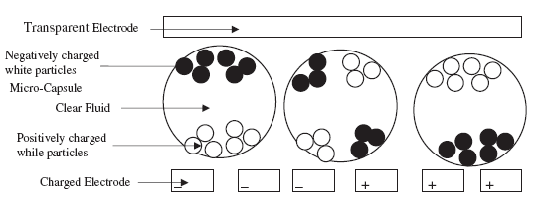
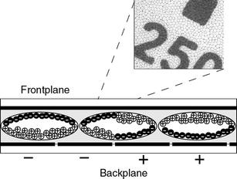

Slide 68
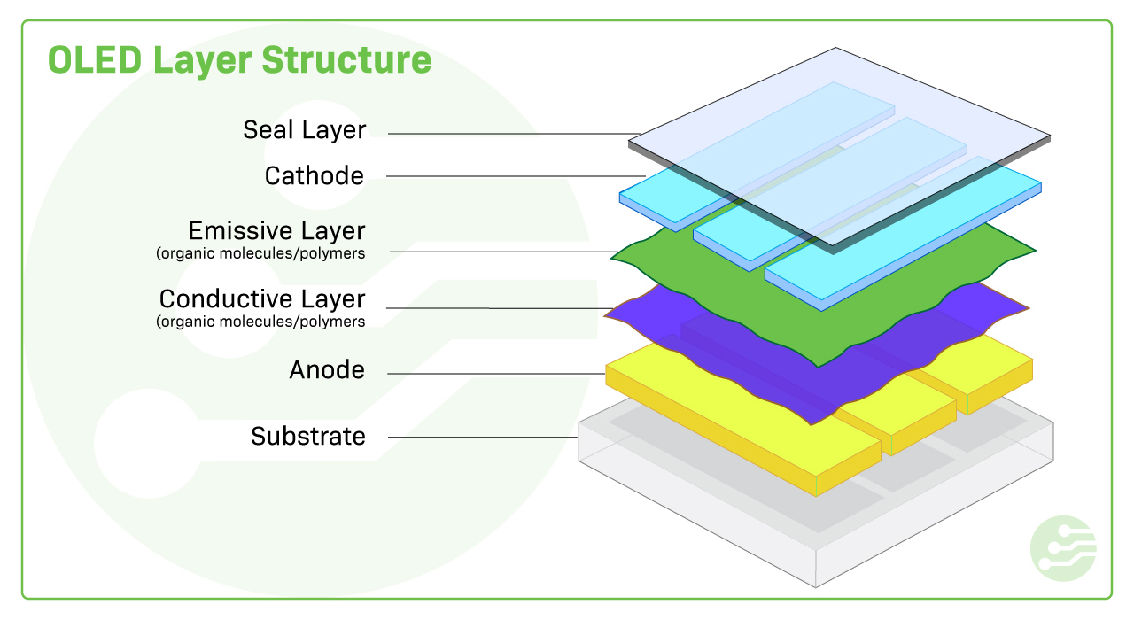
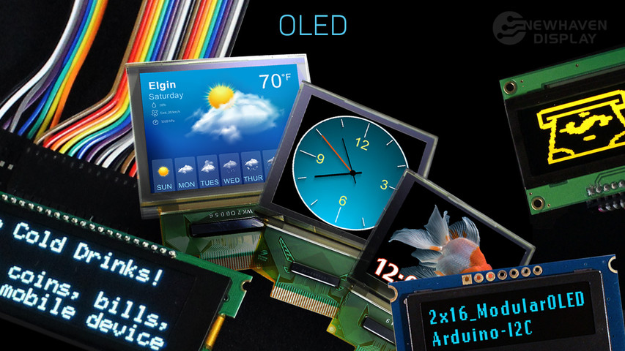
Combining I/O interfaces
Resistive v/s capacitive touchscreen
Tangible user interface (TUI) –augmenting real physical world by connecting digital information to everyday physical objects and environments.
Eg of TUI are ambient wood, datatiles
Organic interface-resemble natural human -physical and human-human interaction
Eg: Organic Light Emitting Diode (OLED) display

Slide 69
Advantages of OLED
Lower cost
Lightweight and flexible
Good resolution
Wider viewing angles and improved brightness
Power efficiency
Eg: samsung galaxy note edge, LG G Flex

Slide 70
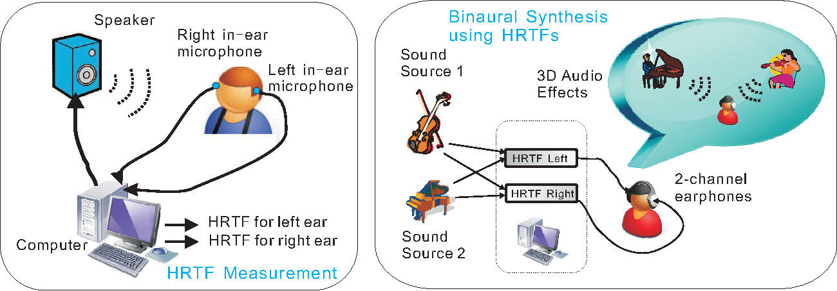
Auditory interface
An Auditory user interface (AUI) is an interface which relies primarily or exclusively on audio for interaction, including speech and sound. (Weinschenk & Barker 2000)
Examples:
Natural Language/Speech User Interfaces.
Hands-free automobile navigational system.
Interactive voice response system (IVR) like automated payment center.
Communicative connections between machine and user
Replacement to keyboard text
For visually impaired users
Challenges- noise removal, ambiguity of commands

